Slide 1
eyeGalaw:
A Google Chrome Extension for Webpage Navigation through Human Gaze

Slide 2
Eyes
Notes:
First let’s discuss a quick background of the study

Slide 3
Notes:
The eyes are considered as the most strained part of the body. Technology today has lead us in the age where our eyes are not just merely used to gather visual information, But the eye movement itself as an input in processes that require interaction.

Slide 4
Why study
eye tracking?

Slide 5
Technology:
Usability
Notes:
USABILITY REFERS TO THE approach that puts the user, rather than the system, at the center of the process.

Slide 6
Technology:
Convenience
Notes:
Devices that are not limited by navigating through touch or mouse clicks expands its usability to people with special needs therefore creates more convenience

Slide 7
Eye tracking:
Convenience
Notes:
This will provide an easier and faster way to perform tasks for everyone.

Slide 8
Usability
Convenience
Notes:
This is exactly the aim of my study: expand usability to everyone and allow convenience not just for normal people but to people with special needs

Slide 9
Google Chrome +
Eye movements +
Web camera
Notes:
To address this aim: The study will develop a Google Chrome extension that enables navigation on active web pages through eye movement using an ordinary web camera

Slide 10
Specifically,
Notes:
Specifically, this study will

Slide 11
1
incorporate basic navigation and advanced navigation methods
Notes:
1) to incorporate basic (normal click and scroll) and advanced (gaze controlled) navigation methods;

Slide 12
2
to detect the user’s gaze location on the screen using an ordinary web camera
Notes:
2) to detect the users gaze location on the screen using an ordinary web camera;

Slide 13
3
navigate active web pages using eye movements
Notes:
This study aims to:
3) to navigate active web pages using eye movements;

Slide 14
How?
(Methodology)

Slide 15
System Requirements
HTML5 and CSS
Javascript
Webgazer.js
Notes:
eyeGalaw will be developed using

Slide 16
Webgazer.js
Notes:
WebGazer.js is an eye tracking library that uses common webcam to process eye movements.
It has self-calibrating model, meaning, increases its accuracy by mapping between the features of the eye and click positions on the screen.

Slide 17
eyeGalaw:
Main Functionalities

Slide 18
1
Settings Tab
Notes:
-PROCEED

Slide 19
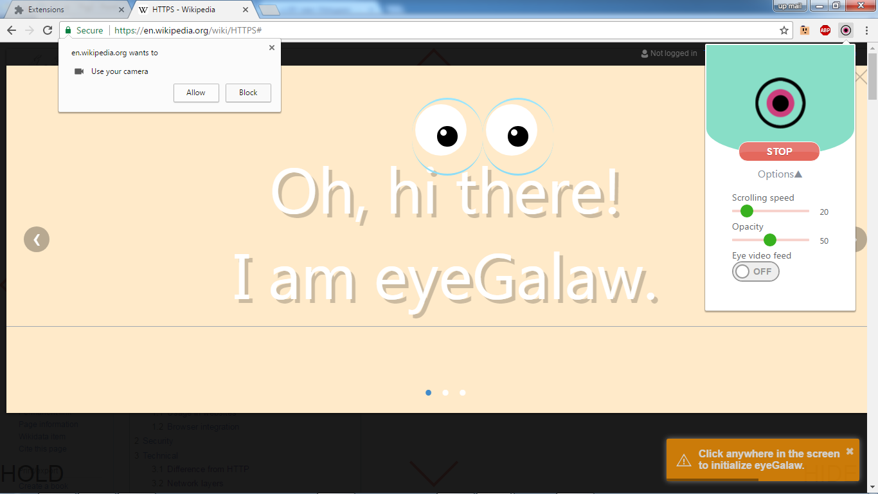
Notes:
-PROCEED

Slide 21
2
Scroll Up and Down,

Slide 22
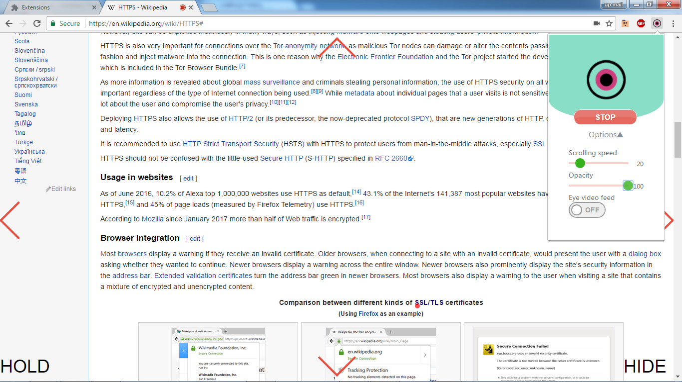

Slide 23
3
Back page and Foward page

Slide 25
4
Hold

Slide 26
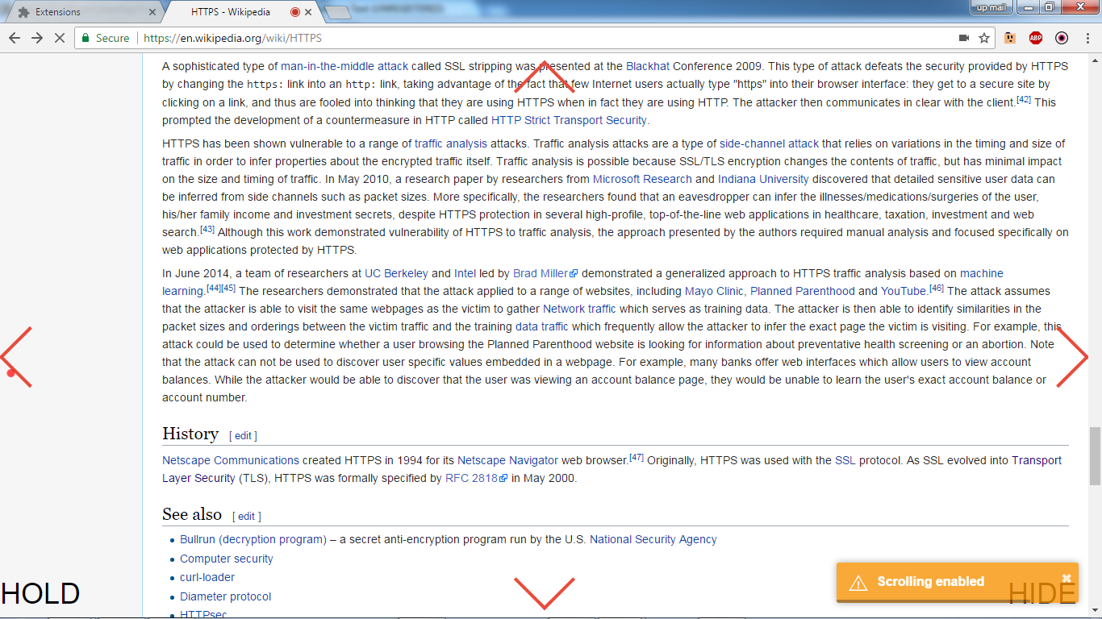
Notes:
Scrolling is enabled

Slide 27
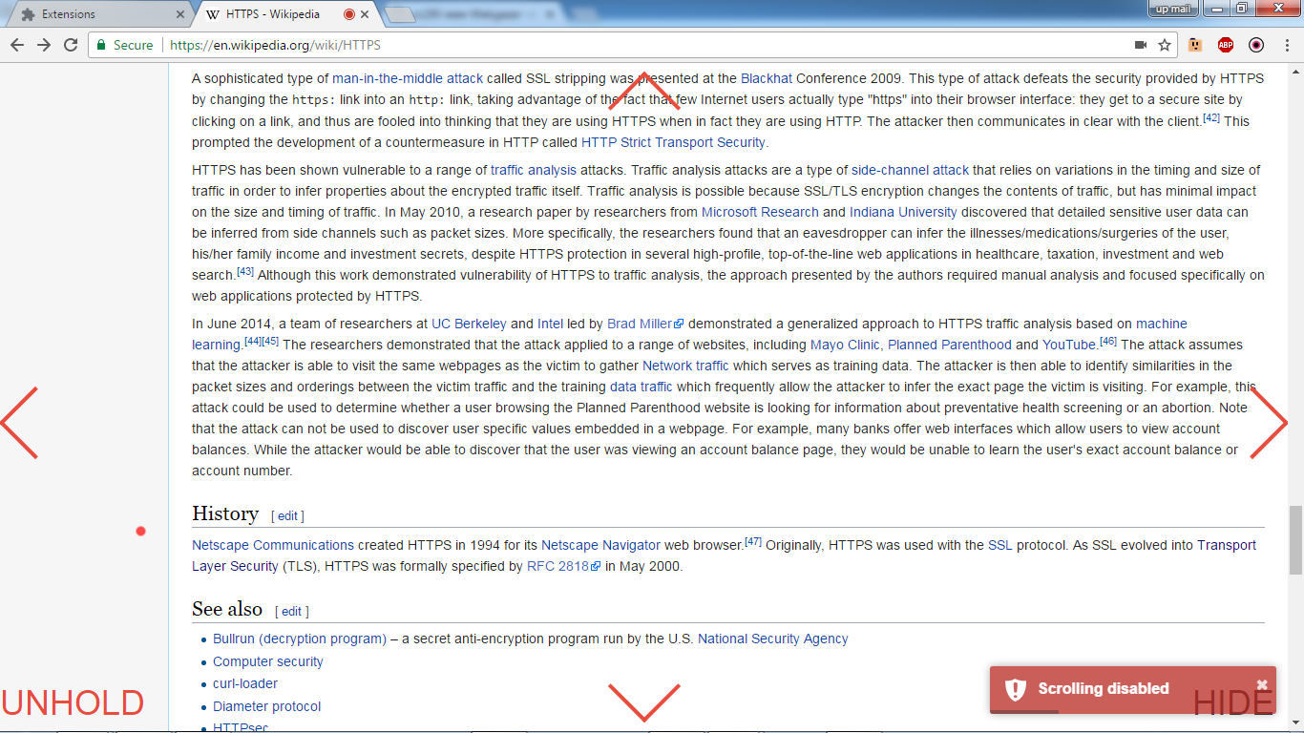
Notes:
Scrolling is disabled

Slide 28
5
Toggle Hide/Show interface

Slide 29
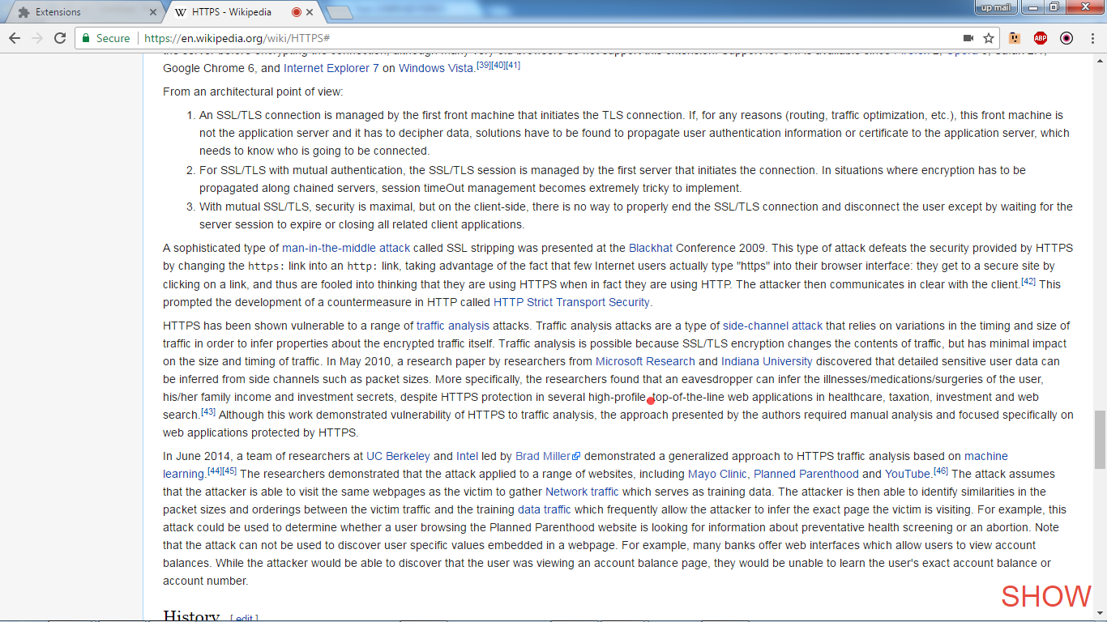
Notes:
DIFFERENCE WITH HOLD - INTERFACE WILL BE ENTIRELY HIDDEN
Here: when hidden, it will be labeled 'Show' (seen on Figure 5).

Slide 30
Results and Discussion

Slide 31
A google chrome extension was developed to navigate using the eye movements.
Notes:
Demo later

Slide 32
Tested by 30 UPLB students
Testing

Slide 33
Testing
Modified Questionnaire for User Interface Satisfaction (QUIS)
Computer System Usability Questionnaire (CSUQ)
Notes:
Analysis of data will be interpreted using Top two box (78%) scoring, which means that a score will be evaluated as satisfactory if a score falls within the top two box and a score falling in the middle category will be considered as a neutral response between not satisfactory (bottom two box) and satisfactory (top two box)

Slide 34
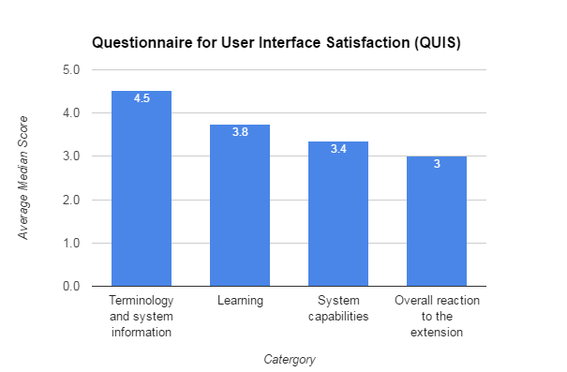
Notes:
Table shows us the summarized Average median scores of the questions under the each sections.
) the average score of 4.5 which means that most of the respondents were satisfied by the consistency of the use of terms throughout extension, the error messages, and the position of messages on screen.

Slide 35
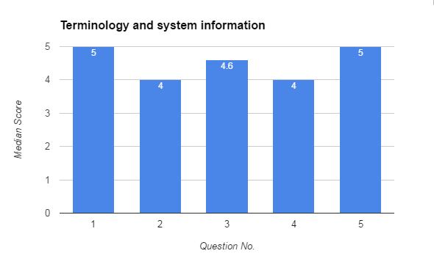
Use of terms throughout system (Inconsistent/Consistent)
Terminology is intuitive (Never/Always)
Position of messages on screen (Inconsistent/Consistent)
Prompts for adjusting input in settings tab (Confusing/Clear)
Error messages (Helpful/Unhelpful)
Notes:
Bar graph Median Score per question

Slide 36
Notes:
average median score of 3.8 out of 5 for the learnability means that it is not difficult but also not very easy. For the overall rating for learning to navigate webpages using eyeGalaw, almost half of the respondents had a difficulty (rating of 3 and below) than the respondents who rated eyeGalaw as easy to learn

Slide 37
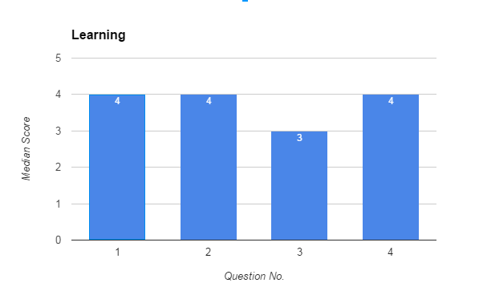
Overall rating for learning to navigate webpages using eyeGalaw (Difficult/Easy)
Learning to operate and adjust eyeGalaw settings (Difficult/Easy)
Learning to navigate a webpage by eyeGalaw (Difficult/Easy)
Performing tasks is straightforward i.e. scrolling up/down, hide controls and disable scrolling. (Never/Always)
Notes:
For the overall rating for learning to navigate webpages using eyeGalaw, almost half of the respondents had a difficulty (rating of 3 and below) than the respondents who rated eyeGalaw as easy to learn

Slide 38
Notes:
The system capabilities section with an average score of 3.6 means that eyeGalaw had issues in its efficiency (See Figure 13). This section evaluated its speed, flexibility to users and error handling.

Slide 39
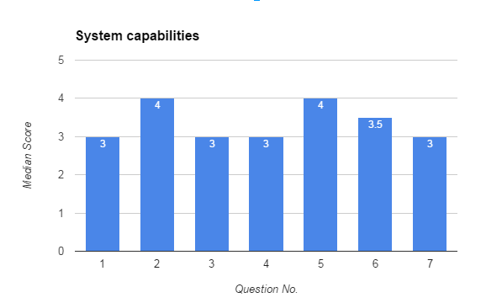
Notes:
But the overall usefulness of eyeGalaw in web page navigation (Question No. 7)was agreed as useful (rating of 3 and above) by 73.4% or 22 out of 30 respondents.

Slide 40
Overall eyeGalaw speed (Too slow/Fast enough)
eyeGalaw startup speed (Too slow/Fast enough)
eyeGalaw speed in responding to the actions that a user does i.e. adjusting settings, navigation. (Too slow/Fast enough)
eyeGalaw failure mechanisms: Errors can occur without warnings, Error messages are displayed correctly (Unreliable/Reliable)
eyeGalaw failure mechanisms: Periodic restarts or refresh can help fix extension problems (Unreliable/Reliable)
eyeGalaw is designed for all levels of users (Never/Always)
Overall usefulness of eyeGalaw in web page navigation (Not Useful/ Very Useful)

Slide 41
Notes:
Respondents overall reaction to the extension was also evaluated receiving an average median score of 3. This means that most of the respondents reacted neutrally between strongly disagreeing and strongly agreeing to the components being evaluated. The items include Difficult / Easy, Terrible / Wonderful, Frustrating / Satisfying, Dull / Stimulating, and Rigid / Flexible.

Slide 42
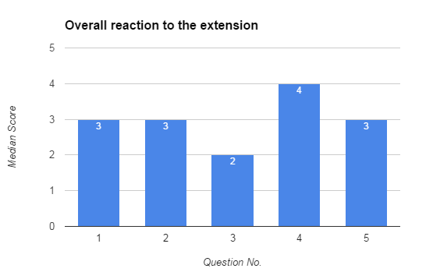
Difficult / Easy
Terrible / Wonderful
Frustrating / Satisfying
Dull / Stimulating
Rigid / Flexible
Notes:
Bar graph per Median Score per Question

Slide 43
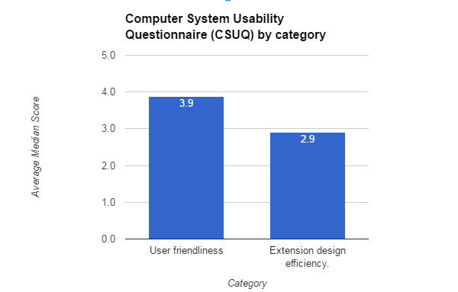
Notes:
From the graph of average median score per section in CSUQ, data showed that the user-friendliness scored an average of 3.9 which means that the user interface of the application was satisfactory. The score of 2.9 in the extension design efficiency denotes that there are still problems in effectively navigating webpages using eyeGalaw.

Slide 44
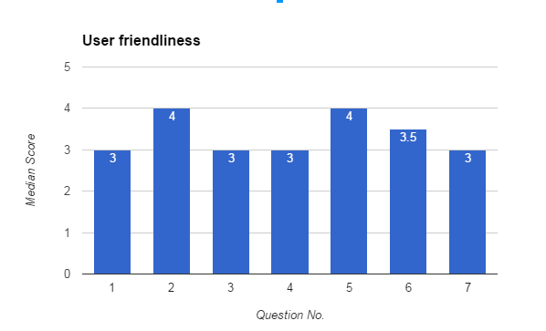
Notes:
1. Overall, I am satisfied with how easy it is to use eyeGalaw
2. It was simple to use eyeGalaw
6. The information (such as online help, on-screen messages, and other documentation) provided with eyeGalaw is clear.
7. It is easy to find the information I needed.
8. The information provided for the system is easy to understand.
9. The organization of information on the system screens is clear.
10.The interface of eyeGalaw is pleasant.
11. I like using the interface of eyeGalaw.

Slide 45
1. Overall, I am satisfied with how easy it is to use eyeGalaw
2. It was simple to use eyeGalaw
6. The information (such as online help, on-screen messages, and other documentation) provided with eyeGalaw is clear.
7. It is easy to find the information I needed.
8. The information provided for the system is easy to understand.
9. The organization of information on the system screens is clear.
10.The interface of eyeGalaw is pleasant.
11. I like using the interface of eyeGalaw.

Slide 46
Notes:
From the graph of average median score per section in CSUQ(see Figure 15), data showed that the user-friendliness scored an average of 3.9 which means that the user interface of the application was satisfactory. The score of 2.9 in the extension design efficiency denotes that there are still problems in effectively navigating webpages using eyeGalaw.

Slide 47
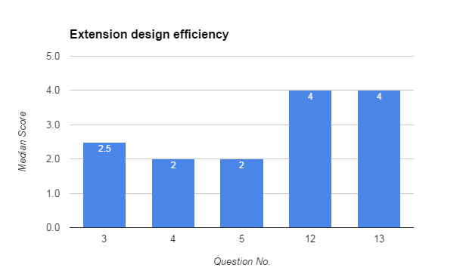

Slide 48
3. I can effectively navigate webpages using eyeGalaw.
4. I can effectively complete my work using eyeGalaw.
5. I can effectively complete my work quickly using eyeGalaw.
12. eyeGalaw has all the functions and capabilities I expect it to have.
13.Overall, I am satisfied with eyeGalaw.

Slide 49
Conclusion and Future Work
Notes:
eyeGalaw, a chrome extension to navigate webpages using the eyes with the help of a web camera was successfully created. The users gaze location on the screen was successfully detected using an ordinary webcam securely. Gaze controlled navigation method was successfully incorporated with the normal click and scroll browsing. Functions were successful with some reservations. Although problems on speed and learnability of the extension hinder its efficiency, the overall usefulness of eyeGalaw in web page navigation is still commendable

Slide 50
Demo

Slide 52
Possible improvements
Response speed and user friendliness
Notes:
Possible improvements on the response speed and user-friendliness should be taken into consideration.

Slide 53
Possible improvements
Inapplication hints and a tutorial mode
Notes:
Adding inapplication hints and a tutorial mode on how to operate eyeGalaw can possibly help ease the user’s difficulty in learning to use the extension.

Slide 54
Possible improvements
Detecting elements in a webpages such as website headers, facebook chat sidebar, and other elements
Notes:
Detecting elements in a webpages such as website headers, facebook chat sidebar, and other elements that may hinder the compatibility of eyeGalaw to websites

Slide 55
In the future..
Google chrome extension to assist persons with locomotor problems and persons with disability
Notes:
This study has been an initial step from the inspiration of developing a google chrome extension to assist persons with locomotor problems and persons with disability. Improvements in the future can extend eyeGalaws capabilities and improve its functionalities for a wider set of users. This could revolutionize web page navigation that caters for everyone, even for people with special needs.

Slide 57
eyeGalaw:
A Google Chrome Extension for Webpage Navigation through Human Gaze

Slide 58
Thank you!

Slide 59
References

Slide 60
Thank you

Slide 61
E. Dimacali and L. Danila, "SurfSocial: A Google Chrome Chat Extension as a Real-Time Forum System", Institute of Computer Science, UPLB. Special Problem, 2016. unpublished paper.
F. Ventocilla and R. Recario, "Enabing speech navigation on active web page using google chrome extension", Institute of Computer Science, UPLB. Special Problem, 2014. unpublished paper.
How to Manually Install Extensions in Google Chrome - Make ... (2014, June). Retrieved November 24, 2016, from https://www.maketecheasier.com/manually-install-extensions-google-chrome
How to Make a Chrome Extension. (2015, January). Retrieved November 24, 2016, from https://robots.thoughtbot.com/how-to-make-a-chrome-extension

Slide 62
Marcus. (2015). Design, user experience, and usability: Interactive experience design. Place of publication not identified: Springer.
Papoutsaki, A., Sangkloy, P., Laskey, J., Daskalova, N., Huang, J., & Hays, J. (2016). WebGazer: Scalable Webcam Eye Tracking Using User Interactions. Proceedings of the 25th International Joint Conference on Artificial Intelligence (IJCAI). Proceedings of the 25th International Joint Conference on Artificial Intelligence (IJCAI), 3839-3845.
Shimojo, S., Simion, C., Shimojo, E., & Scheier, C. (2003). Gaze bias both reflects and influence preference. Nature Neuroscience, 6, 1317–1322.
Usability 101: Introduction to Usability. (n.d.). Retrieved November 27, 2016, from https://www.nngroup.com/articles/usability-101-introduction-to-usability/
Usability in Software Design. (n.d.). Retrieved November 27, 2016, from https://msdn.microsoft.com/en-us/library/ms997577.aspx
W3C. (n.d.). Retrieved November 24, 2016, from https://www.w3.org/standards/webdesign/htmlcss

Slide 63
Thank you

Slide 64
Webgazer.js
Notes:
WebGazer.js is an eye tracking library that uses common webcam to process eye movements.
It has self-calibrating model, that increases its accuracy by mapping between the features of the eye and click positions on the screen.

Slide 65
